Slide 1
CT technique update: double reduction in radiation dose and contrast amount
Chung Yong Eun
Yonsei University, Severance hospital

Slide 2
Content
Introduction
Unit of radiation
Definition of low dose radiation
Radiation dose reduction: Why?
DNA damage
Biologic effect of radiation
How to reduce radiation dose during CT: Optimization of CT protocol
Automatic exposure control
Adjusted kVp selection
Iterative reconstruction
Double dose reduction
Notes:
Today, I would like to talk about the radiation dose and contrast media reduction during CT.

Slide 3
Introduction
Notes:
I’ will start with the reason why we should reduce radiation dose.

Slide 4

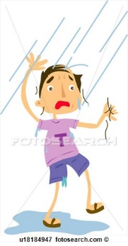
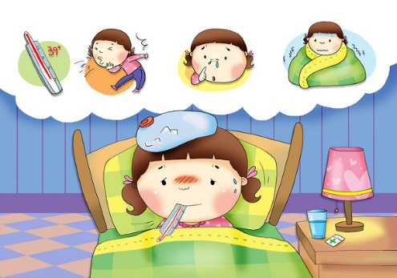
Introduction - Unit
Exposure (조사선량)
The amount of electrical charge produced by ionizing EM radiation per mass of air
X = ΔQ / Δm
Units: Roentgens = 2.58 * 10⁻⁴ C/kg
Absorbed dose (흡수선량)
The amount of energy that is actually absorbed at a specific point in space
Units: Gray (1Gy = 1J/kg)
Effective dose (유효선량)
Takes into account 1) types of radiation, 2) Radiosensitivity of the tissues
Units: Sievert (Sv)

Slide 5
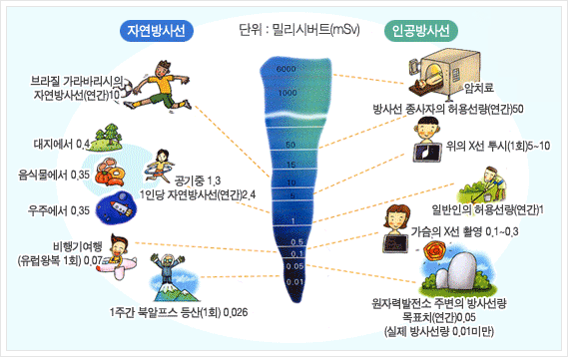
Definition – Low dose radiation
Low dose radiation : 100 mSv or less
Imaging | Effective dose (mSv)
Chest x ray | 0.02
Skull x ray | 0.1
Lumbar spine | 1.5
I.V. urogram | 3
UGI | 8
CT head | 2
CT abdomen | 8
http://www.fda.gov

Slide 6
Radiation dose reduction: Why?
Notes:
I’ will start with the reason why we should reduce radiation dose.

Slide 7
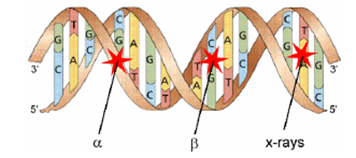
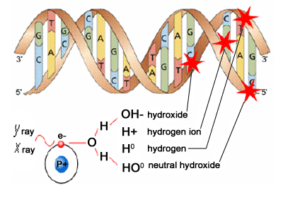
Response to Radiation
Direct effect
Response to ionizing radiation
Damage such as breaking sugar phosphate backbones or base pairs of the DNA can occur either by direct or indirect action.
Indirect effect
http://teachnuclear.ca
Notes:
When cells are exposed to ionizing radiation, damage such as breaking sugar phosphate backbones or base pairs of the DNA can occur either by direct or indirect action.

Slide 8
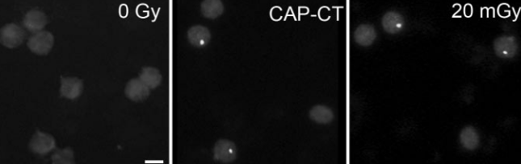
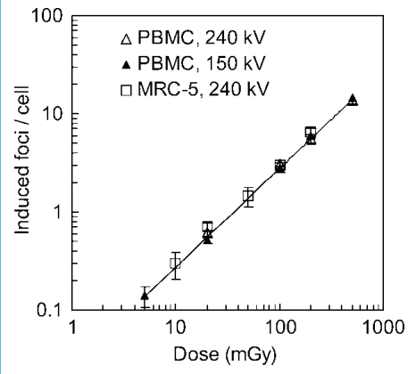
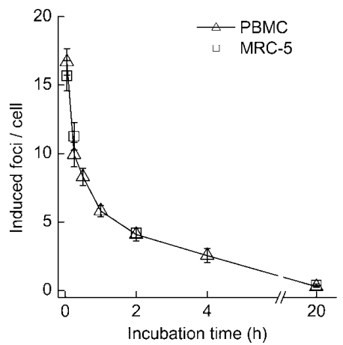
Response to Radiation
Rothkamm, Balroop et al. 2007
Notes:
According to previous studies which quantitatively evaluate leukocyte DNA damage after CT, DNA damage showed peak value just after radiation exposure and there was linear relationship between exposed radiation dose and DNA damage. But, the number of DNA damage decreased as time passed and close to zero after 20 hours.

Slide 9
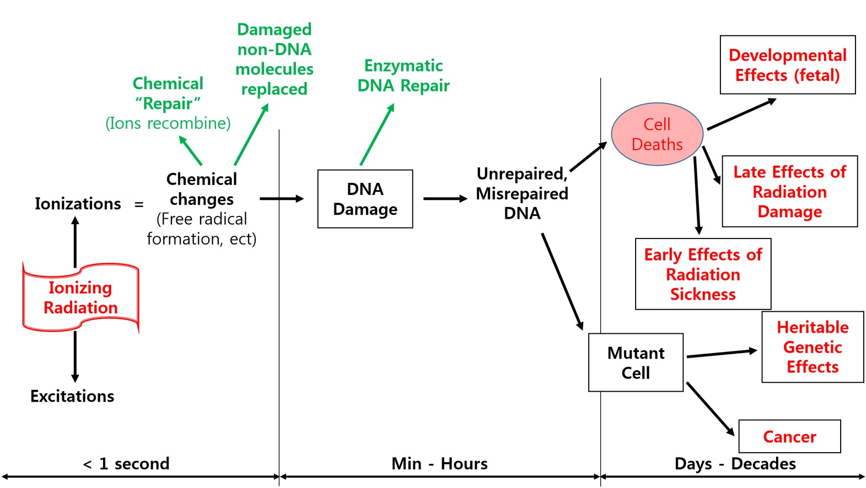
Response to Radiation
DNA damage repair (DDR) mechanism
Mismatch repair (MMR)
Base excision repair (BER)
Nucleotide excision repair (NER)
Nonhomologous end joining (NHEJ)
Homologous recombination (HR)
http://www.sigmaaldrich.com/technical-documents/articles/biofiles/dna-damage-and-repair.html
Notes:
However, harmful effect of radiation do not occur in all of the people who exposed to radiation because there are various repair mechanisms for DNA damage.

Slide 10
Response to Radiation
http://www.sigmaaldrich.com/technical-documents/articles/biofiles/dna-damage-and-repair.html
Notes:
However, harmful effect of radiation do not occur in all of the people who exposed to radiation because there are various repair mechanisms for DNA damage.

Slide 11
Radiation dose reduction: How?
Notes:
Then How we can reduce radiation dose?

Slide 12
Radiation dose reduction: How?
Controllable parameters that contribute to radiation dose during CT
∝ 1/Patients size
∝ 1/Helical Pitch
∝ Rotation Time
∝ mA(s) (Photon fluence)
∝ (kVp )^{2.5~2.8} (Beam energy)
Hamberg et al. Radiology. 2003 Mar;226(3):762-72.
McNitt-Gray et al. Radiographics. 2002 Nov-Dec;22(6):1541-53.
Notes:
In this time, I will focused on how can we reduce radiation dose during CT scan. Because CT is responsible for most of the recent increase of medical radiation exposure.
There are several controllable parameters that contribute to radiation dose during CT scan.
We can reduce radiation dose by increasing helical pitch or decreasing rotation time, but these parameters are usually determined at the time of protocol design and can not be adjusted to each patient.

Slide 13
Radiation dose reduction: How?
Controllable parameters that contribute to radiation dose during CT
∝ 1/Patients size
∝ 1/Helical Pitch
∝ Rotation Time
∝ mA(s) (Photon fluence)
∝ (kVp )^{2.5~2.8} (Beam energy)
Hamberg et al. Radiology. 2003 Mar;226(3):762-72.
McNitt-Gray et al. Radiographics. 2002 Nov-Dec;22(6):1541-53.
Notes:
Whereas, tube current and tube voltage can be adjusted to each patients or even to scanned body parts

Slide 14
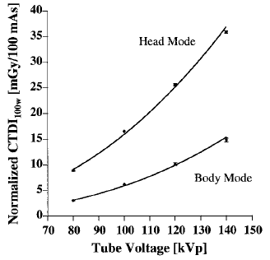
Controllable Parameters
Tube current
Tube voltage
Dose ∝ Tube current
Linear relationship
Dose ∝ Tube voltage
Nonlinear relationship
Hamberg et al. Radiology. 2003 Mar;226(3):762-72.
Notes:
Rradiation dose increases as increasing both tube current and tube voltage.
But the relationship between them is different: linear relationship for tube current; and nonlinear relationship for tube voltage
Changing tube current is technically easier than changing tube voltage, hence automatic tube current modulation technique has been firstly developed and applied.

Slide 15
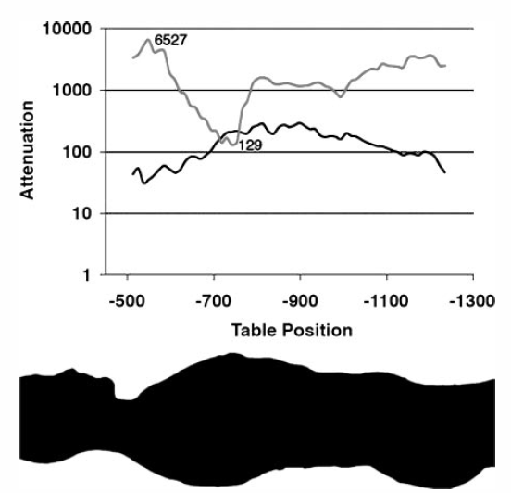
Automatic Exposure Control (AEC)
Adjust mAs according to the patient’s attenuation for minimizing radiation exposure without deteriorating image quality
20-40% of radiation dose can be reduced
Longitudinal (z) mA modulation
Angular (x,y) mA modulation
Angular + Longitudinal mA modulation
 | GE | Philips | Simens | Toshiba
AEC software | Smart mA (XY) Auto mA (Z) ODM | DoseRight Automatic current selection (ACS) Z-DOM, 3D-DOM | CARE Dose 4D | SureExposure
Method for operator control of AEC | Noise Index | Reference Image | Reference mAs | Standard deviation
Lee CH. Radiographics 2008;28:1451-1459.
McCollough CH, Radiol Clin North Am 2009;47:27-40.
Notes:
I believe that most of you already know about AEC. In summary, AEC is adjusting tube current according to the patient’s attenuation for minimizing radiation exposure without deteriorating image quality.
Recently the simultaneous combination of angular and longitudinal tube current modulation involves variation of the tube current both during gantry rotation and along the z axis of the patients.
Most of the major vendors have already commercialized AEC with various names and through AEC, 20-40% of radiation dose can be reduced.

Slide 16
Adjusted kVp based on patient’s size
↓ radiation dose by adjusting kVp according to patient’s size
Care kV (Siemens), Assist kV(GE)
Automatic or semi-automatic kVp and corresponding mAs recommendations to each patients
To maintain a specific image quality while minimizing dose
Additional 20-40% of radiation dose reduction
McCollough CH, Radiol Clin North Am 2009;47:27-40.
Notes:
We can also reduce radiation dose by adjusting tube voltage based on patient’s size.
However, adjusting tube voltage is more complicated than that of tube current because the relationship between tube current, tube voltage and image quality (CNR) in CT is an intricate.
Hence manual determination of these parameters to each patient is time consuming and practically impossible.
To overcome these challenges, major vendors have developed the software which automatically or semi-autometically selects or recommends the optimal tube voltage and corresponding tube current to each patients
By this software, we can maintain a specific image quality while minimizing dose

Slide 17
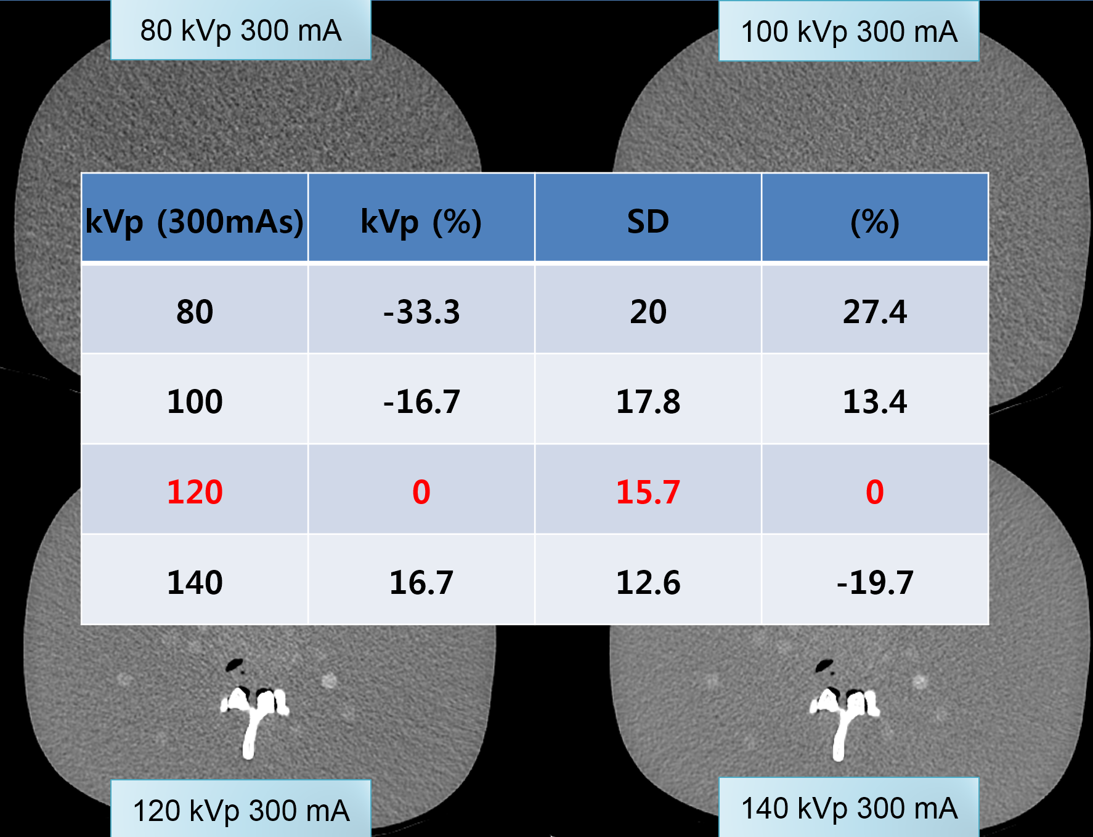
Adjusted kVp based on patient’s size
Drawbacks of low kVp protocol
전반적인 Noise (SD)증가
higher absorption of low-energy photons by the patients.
Need ↑ mAs to maintain image noise
Iterative reconstruction 적용 필요
McCollough CH, Radiographics. 2006 Mar-Apr;26(2):503-12
Notes:
The drawback of low kVp protocol is an increase of image noise because of the higher absorption of low-energy photons by the patients. Hence increasing mAs is inevitable to maintain same image noise corresponding to that of standard kVp image.
However, it is clinically undesirable to maintain constant image noise in low kVp image compared to that of standard kVp image, because our goal, i.e.(that is) radiation dose reduction may not be accomplished.
In obese patient, it is also not technically feasible because CT systems cannot achieve such extremely high mAs.
In this situation, we can choose one of two options. First, endure image noise or second, use iterative reconstruction to reduce image noise.

Slide 18
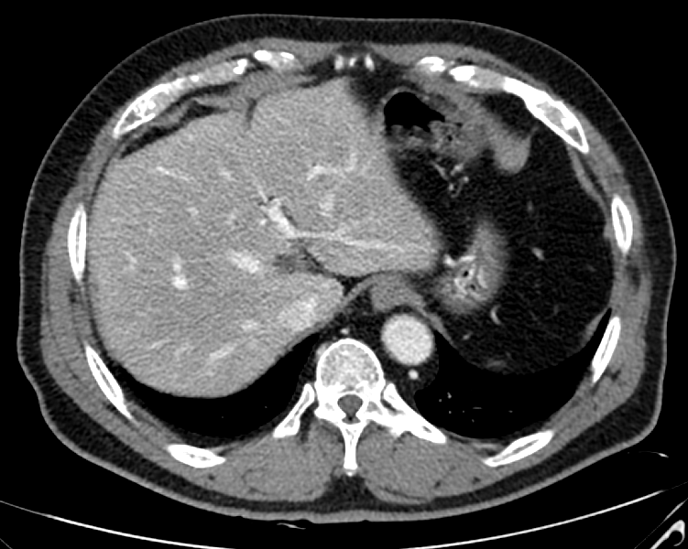
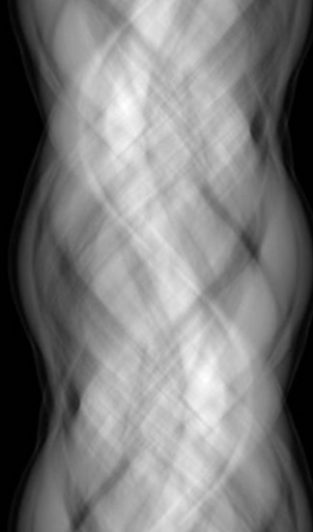
Iterative Reconstruction
Iterative reconstruction
Back projection: images are reconstructed from projection data
Forward projection: projection data are generated from images
Estimated projections are compared with the actual measured projections acquired by the CT
This comparison is then used to update the original estimate
Forward Projection
Back Projection
IR
Compare and Update
Nelson, R. C. J Cardiovasc Comput Tomogr. 2011 Sep-Oct;5(5):286-92.
Willemink, M. J.Eur Radiol. 2013 Jun;23(6):1623-31
Notes:
The concept of iterative reconstruction was introduced prior to FBP. But, due to the limited computation power and robustness of FBP, it had not been widely used. However, in the era of radiation dose reduction together with the recent improvement of computation power, various IR techniques have been available in commercialized CT.
Although the exact mechanisms of commercialized IR algorithms are not available, the basic mechanism of IR is as follows:
Firstly images are reconstructed from projection data, and then projection data are generated from images by forward projection, and this estimated projections are compared with the actual measured projections acquired by the CT. This comparison is then used to update the original estimate. This process is repeated until the specific goal i.e. certain image quality is achieved.

Slide 19
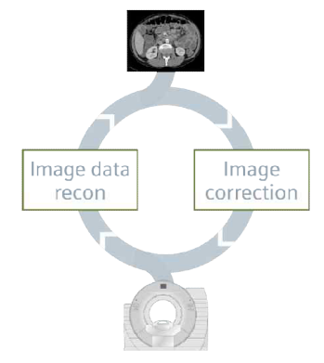
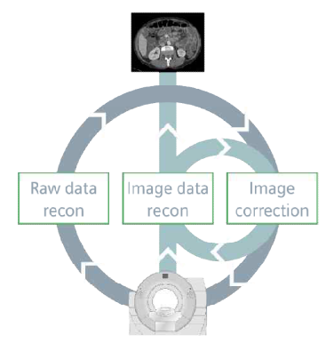
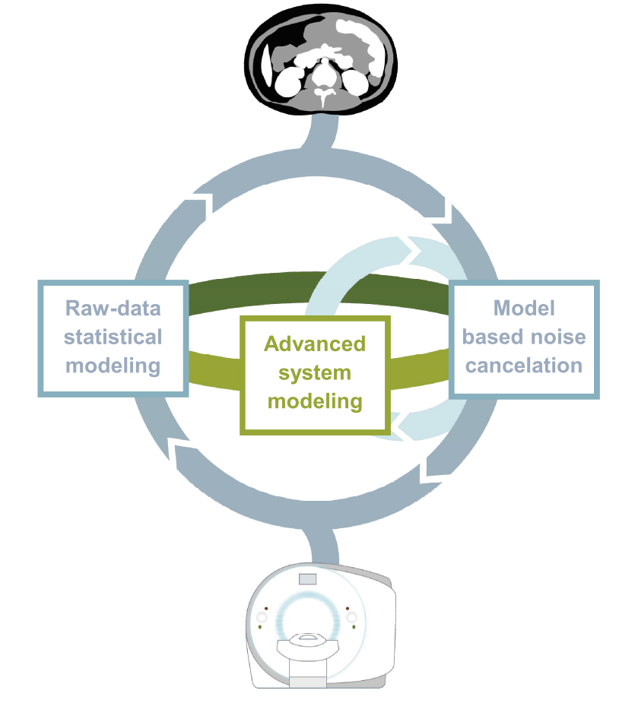
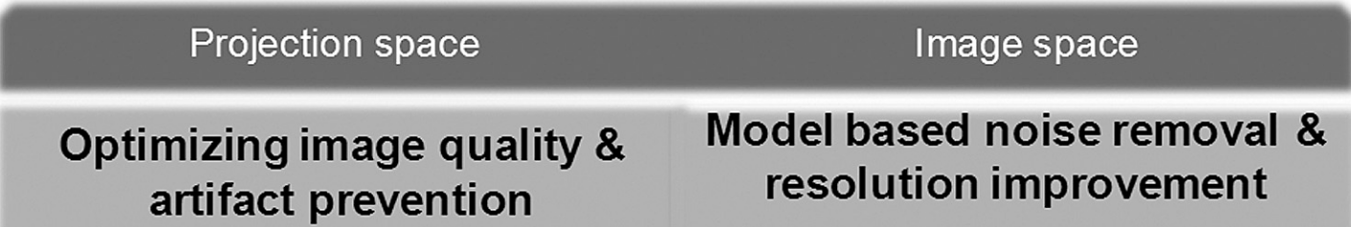
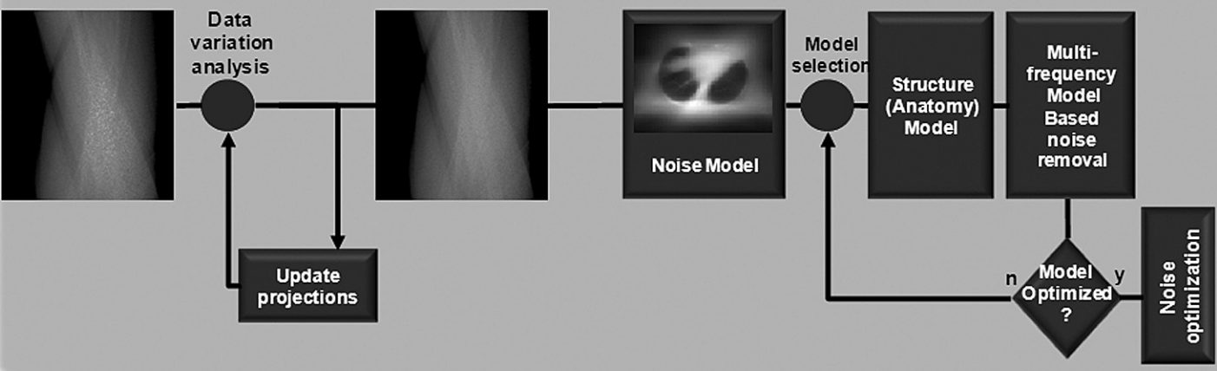
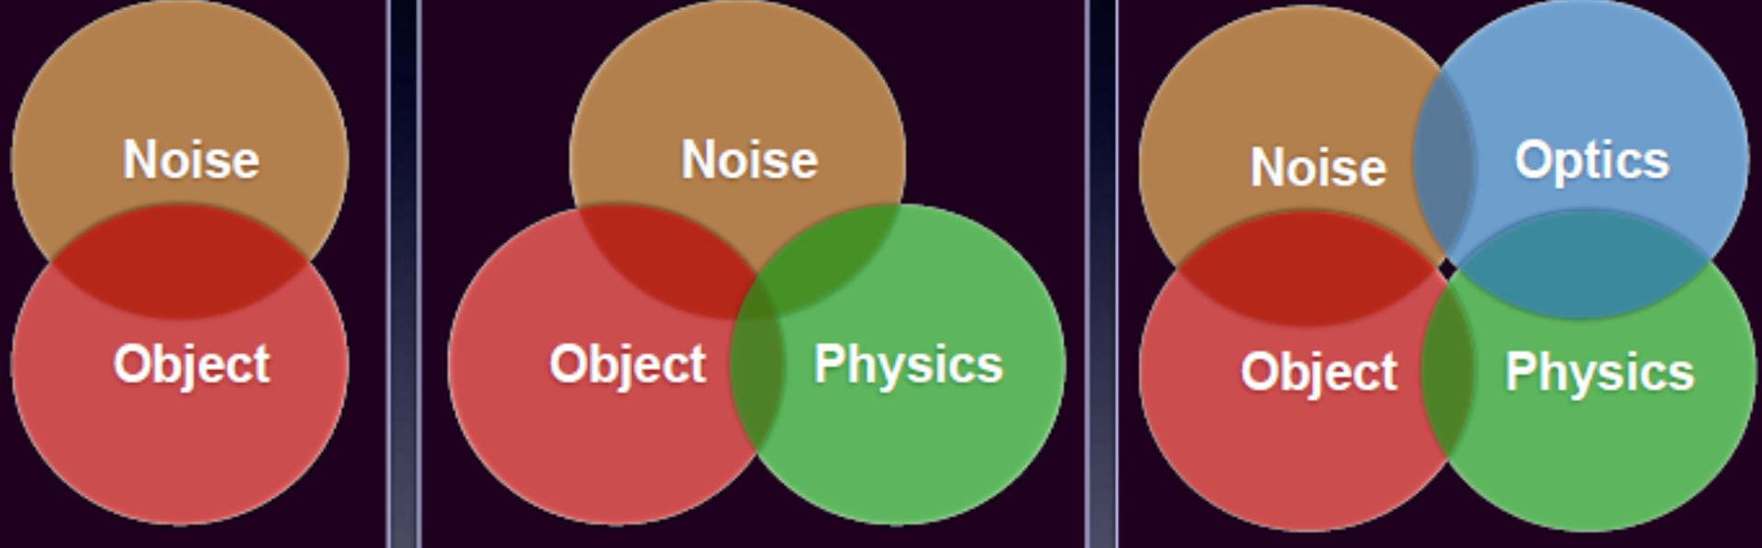

Iterative Reconstruction
Siemens
Philips
IRIS
SAFIRE
ADMIRE
ASiR
ASiR-V
VEO
iDose⁴
GE
White paper from Siemens, GE, Philips
Notes:
IR technique can be classified into two categories based on presence or absence of back projection blending

Slide 20
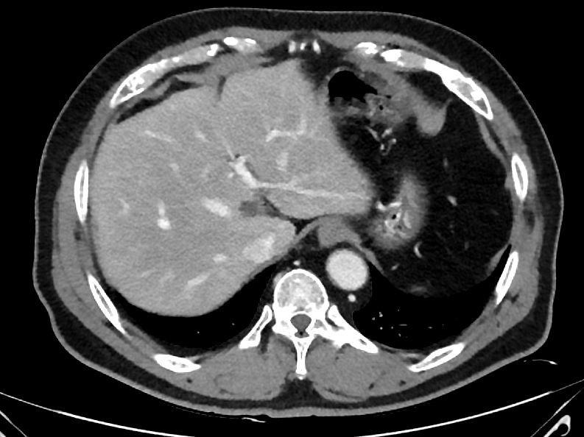
Iterative Reconstruction
Image domain
Noise identification
IRIS
IR
Up to 50(or 90)% of radiation dose reduction
ASiR
iDose⁴ SAFIRE
AIDR 3D
Back Projection
IR
Noise identification
MBIR
Projection domain
Nelson, R. C. J Cardiovasc Comput Tomogr. 2011 Sep-Oct;5(5):286-92.
Notes:
IR can also be categorized based on the domain space of iterative loop.
Iterative reconstruction can be perform in image domain alone such as IRIS or projection domain alone such as Veo or in both domains such as ASiR, idose, safire. Anyhow, each iteration updates the image into a less noisy image, leading to an optimized final image.

Slide 21
Iterative Reconstruction
Disadvantages of IR
Need longer reconstruction times and higher computational power compared to FBP
Limitation in metal artifact reduction
Blotch, pixelated appearance of images
Decreasing low contrast resolution in strong IR setting
Khawaja,Pediatr Radiol. 2015 Jul;45(7):1046-55
Notes:
However, there are several disadvantages of IR compared to FBP.
Most of the IR techniques need slightly longer reconstruction time compared to FBP
Another disadvantage is blotch, pixelated appearance of images

Slide 22
Iterative Reconstruction
Disadvantages of IR
Need longer reconstruction times and higher computational power compared to FBP
Limitation in metal artifact reduction
Blotch, pixelated appearance of images
Decreasing low contrast resolution in strong IR setting
Khawaja,Pediatr Radiol. 2015 Jul;45(7):1046-55
Notes:
However, there are several disadvantages of IR compared to FBP.
Most of the IR techniques need slightly longer reconstruction time compared to FBP
Another disadvantage is blotch, pixelated appearance of images

Slide 23
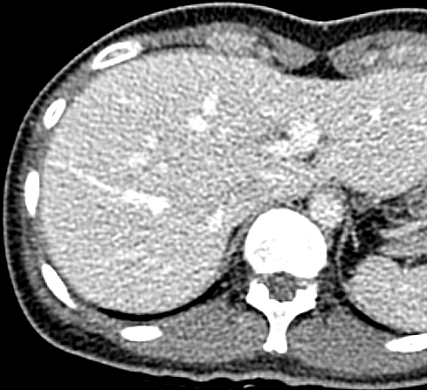
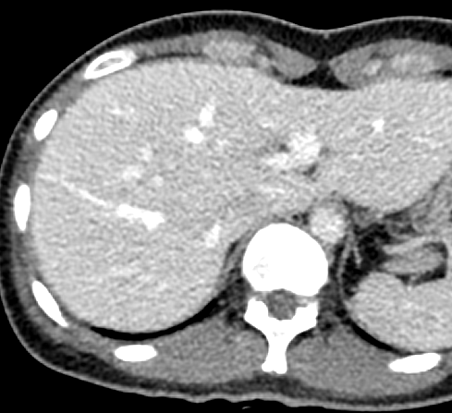
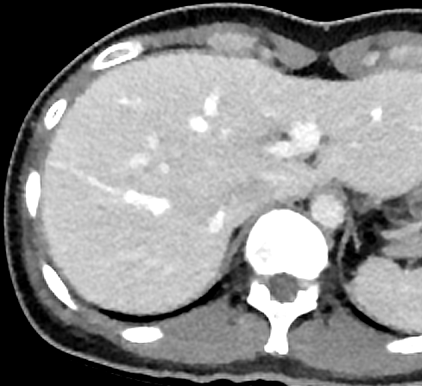
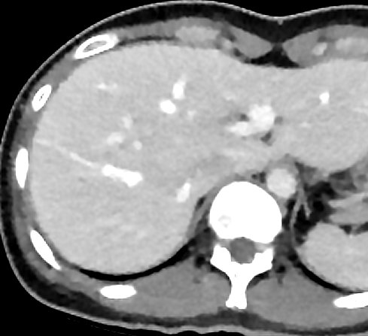
Iterative Reconstruction
FBP
Medium IR
Strong IR
After applying IR, general image noise decreases, but, there is also some artificial blotchy appearance of image.
Moreover, this image appearance is usually pronounced at higher levels of IR algorithms, resulting in potentially precluding exploitation of the full potential of IR for reducing the radiation dose of CT examinations.
Notes:
As you can see in this figures, after applying IR, general image noise decreases, but, there is also some artificial blotchy appearance of image. Moreover, this image appearance is usually pronounced at higher levels of IR algorithms, resulting in potentially precluding exploitation of the full potential of IR for reducing the radiation dose of CT examinations.

Slide 24
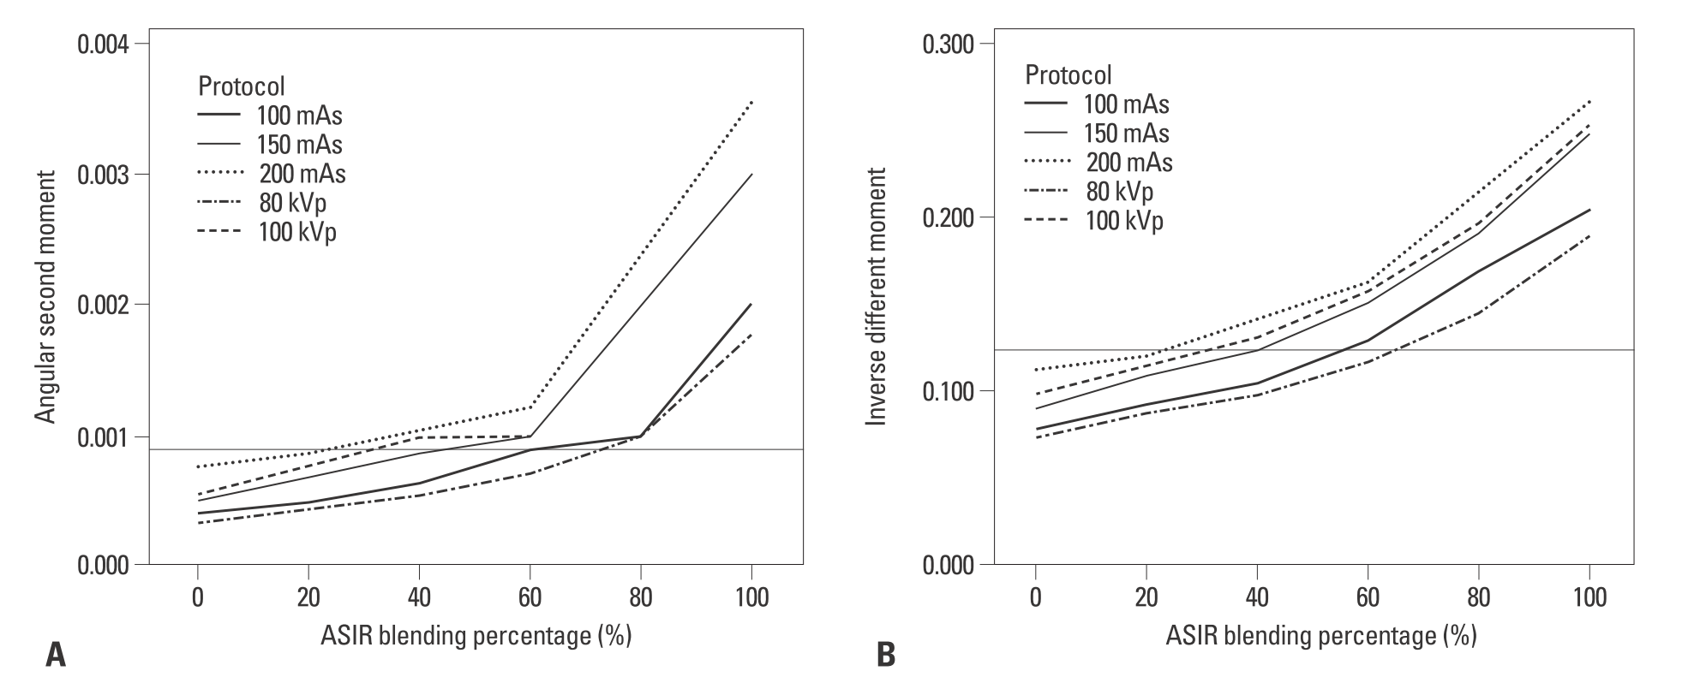
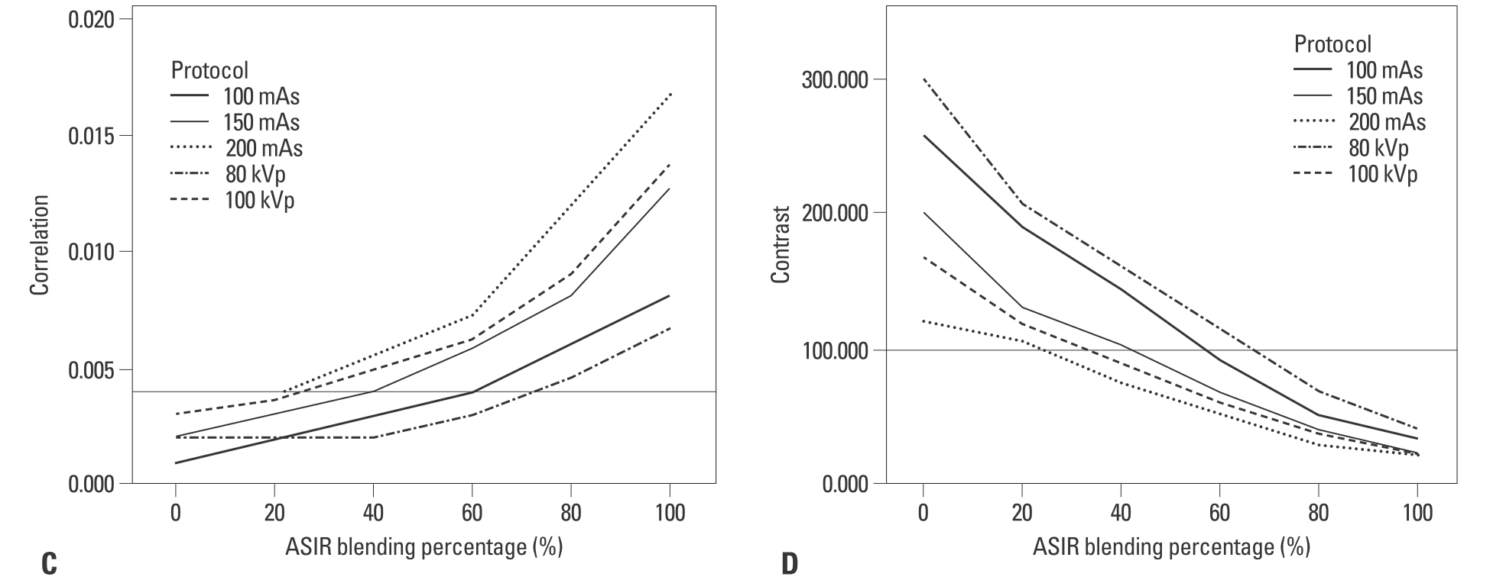
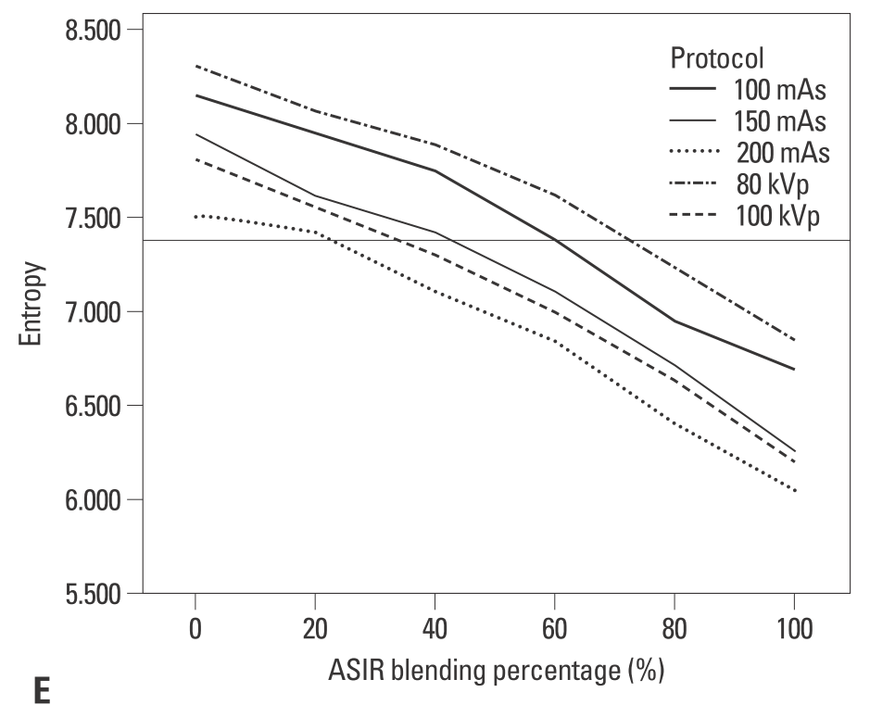
Texture analysis
ASM
IDM
GLCM (grey-level co-occurrence matrices) method
Angular second momentum (ASM), Inverse difference moment (IDM): represent measures of homogeneity
Correlation: gray-tone linear dependencies within the image, high correlation value means a more consistent text value.
Contrast: the amount of local variation
Entropy: higher entropy values mean less homogeneous image texture
Correlation
Contrast
Images with 40% ASIR from 40% radiation reduction CT (from 250 mAs to 150 mAs) is similar image texture compared to full dose FBP image
Entropy
Kim, H. G. Chung, Y.E. Yonsei Med J. 2015 Jan;56(1):253-61
Notes:
We analyzed image texture after applying IR by using grey-level co-occurrence matrices (GLCM) method, which calculate five parameters that are related to image texture.
And we found that images with 40% ASIR from 40% radiation reduction CT (from 250 mAs to 150 mAs) is similar image texture compared to full dose FBP image

Slide 25
Iterative Reconstruction
Disadvantage of IR
Longer reconstruction times and higher computational power, especially the case for MBIR (10-90 min)
Blotch, pixelated appearance of images
Decreasing low contrast resolution in strong IR setting
Although IR techniques allow substantial noise reduction while maintaining high-contrast spatial resolution, low contrast resolution can be degraded by IR.
Morsbach, F.Invest Radiol. 2016 Aug 19.
Khawaja,Pediatr Radiol. 2015 Jul;45(7):1046-55
Notes:
Another drawbacks of IR is a decrease of low contrast resolution in strong IR setting. Although IR techniques allow substantial noise reduction while maintaining high-contrast spatial resolution, low contrast can be degraded by IR.

Slide 26
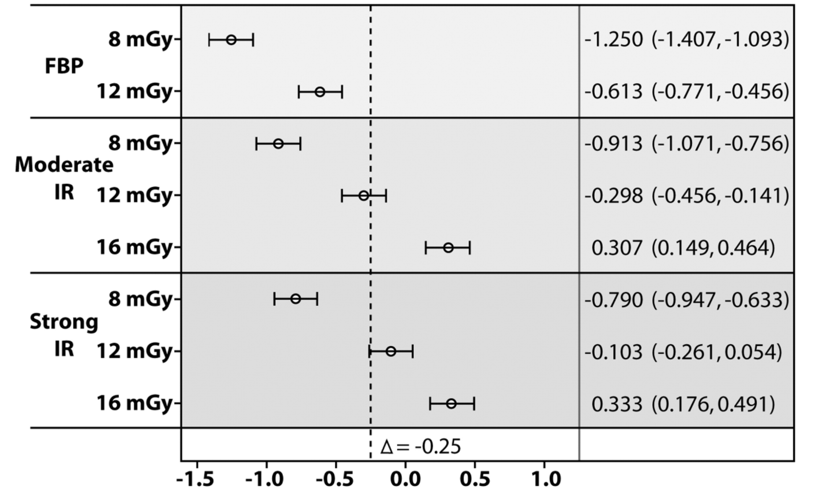
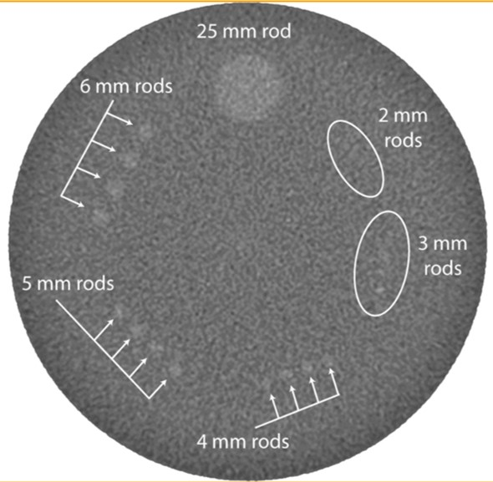
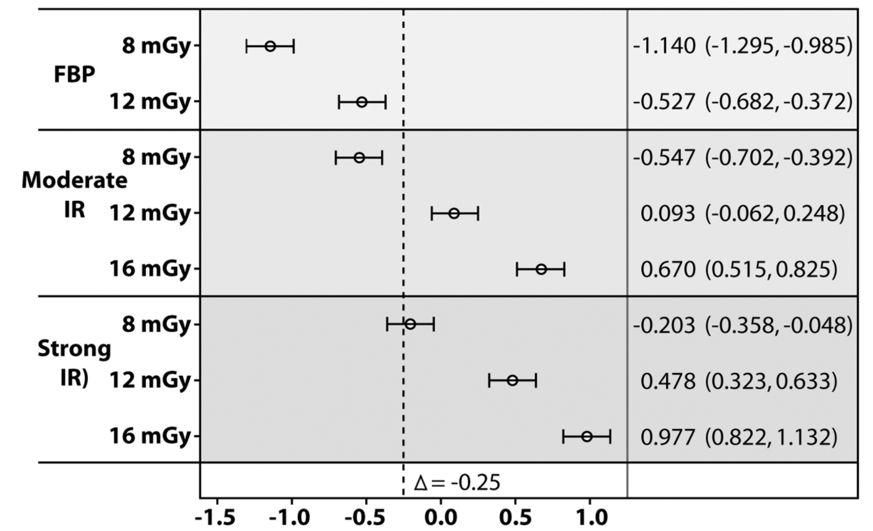
Disadvantage of IR-Low contrast resolution
Low contrast resolution performance by ACR
All four 6-mm rods were deemed to be visible by the physicist reviewer to pass the passing criteria.
Lightspeed VCT w/ ASIR
Radiation dose reductions of 25%–50% with IR reduce the LCR relative to that achieved by using the full dose and FBP.
ACR CT Accreditation Program phantom
Somatom Definitoin flash w/ SAFIRE
McCollough, C. H. Radiology. 2015 Aug;276(2):499-506
Notes:
Furthermore, in this phantom study, Radiation dose reductions of 25%–50% with IR reduce the LCR relative to that achieved by using the full dose and FBP.

Slide 27
Iterative Reconstruction
Disadvantage of IR
Longer reconstruction times and higher computational power, especially the case for MBIR (10-90 min)
Blotch, pixelated appearance of images
Decreasing low contrast resolution in strong IR setting
IR algorithm can not preserve the low-contrast detectability in CT scan which is obtained below the certain level of radiation dose.
Hence it is reasonable to apply medium degree of IR with less than 50% dose reduction for abdominal (liver) CT protocol.
Morsbach, F.Invest Radiol. 2016 Aug 19.
Khawaja,Pediatr Radiol. 2015 Jul;45(7):1046-55
Notes:
Based on these results, we can assume that IR algorithm can not preserve the low-contrast detectability in CT scan which is obtained below the certain radiation level.
Hence it is reasonable to apply medium degree of IR with less than 50% dose reduction for abdominal CT protocol.

Slide 28
Iterative Reconstruction
Author | Year | Dose reduction | CTDIvol (mGy) | IR technique | Target Dz
Kwon, H.J. | 2015 | 35.37% | 5.04 | ASIR_V 30-50% | Abdomen
Park, H.J. | 2016 | 27% | 8.8 | IMR | HCC
Shin, H.J. | 2013 | 41.30% | 18.9 | SAFIRE 3-4 | Abdomen
Park, M.N. | 2014 | 50% | 5.63 | SAFIRE 2 | Liver metastasis
Boning | 2015 | 37.60% | 6.34 | ASIR 40% | Neuroendocrine tumor
Song, J.S . | 2015 | 47% | 4.7 | SAFIRE 2 | Liver
Pooler | 2016 | 60-70% | 5.04 | ASIR 25-40%, MBIR | Liver low contrast lesion | Not appropriate
Vardhanabhuti | 2014 | 85% | 2 | MBIR | Abdomen | Not appropriate
Khawaja | 2015 | 85% | 1.2 | IMR | Liver | Not appropriate
Notes:
And as you can see in this table, most of the studies adopted medium degree of IR with less than 50% dose reduction.
In studies which reduce radiation dose more than 60%, low contrast resolution can not be preserved even after applying full IR technique, MBIR or iMR

Slide 29
Double Dose reduction
Notes:
Now I will move on to the last topic ‘double dose reduction.’

Slide 30
Double Dose reduction
Double dose reduction
Reduce both radiation dose and CM dose by lowering tube voltage.
Benefit of low kVp protocol
Radiation dose reduction
HU of iodine increases
As tube voltage decreases, it becomes closer to the k-edge of iodine and the photoelectric absorption of iodine increases, resulting in increased HU of iodine on CT
Notes:
Double dose reduction describe scanning protocol to reduce both radiation dose and CM dose by lowering tube voltage.
As mentioned before, radiation dose can be reduced by decreasing tube voltage. Another advantage of low kVp protocol is that attenuation value of iodine increases.
As tube voltage decreases, it becomes closer to the k-edge of iodine and the photoelectric absorption of iodine increases, resulting in increased Hounsfield Units (HU) of iodine on CT

Slide 31
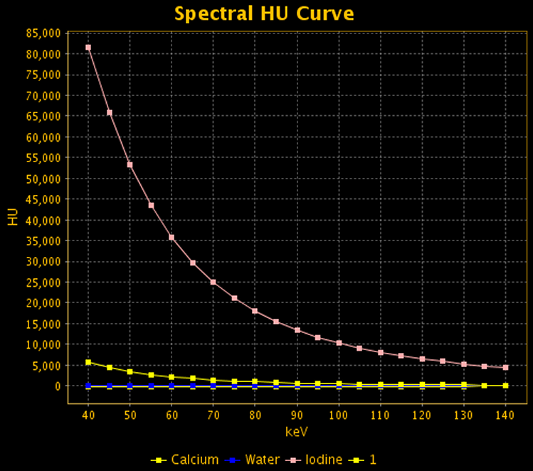
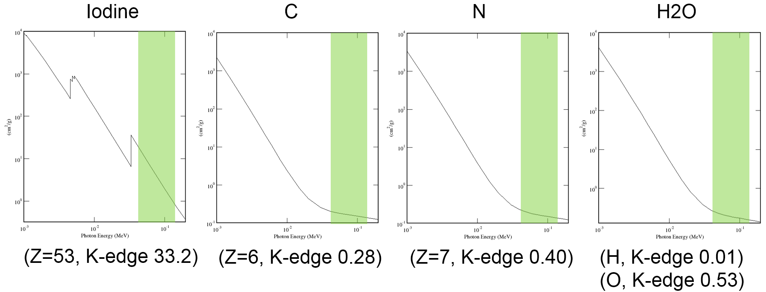
Double Dose reduction
Low kVp protocol
Iodine manifests with higher HU values than it does with the standard CT technique, even with the same CM dose.
↑ conspicuity of hyper- and hypo-vascular structure or lesions
Iodine
Notes:
Which means that with the low tube voltage, iodine manifests with higher HU values than it does with the standard CT technique, even with the same CM dose, resulting in increasing conspicuity of hyper- and hypo-vascular structure or lesions

Slide 32
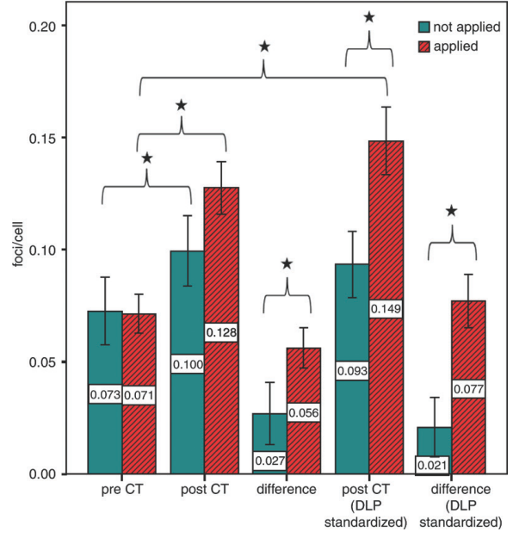
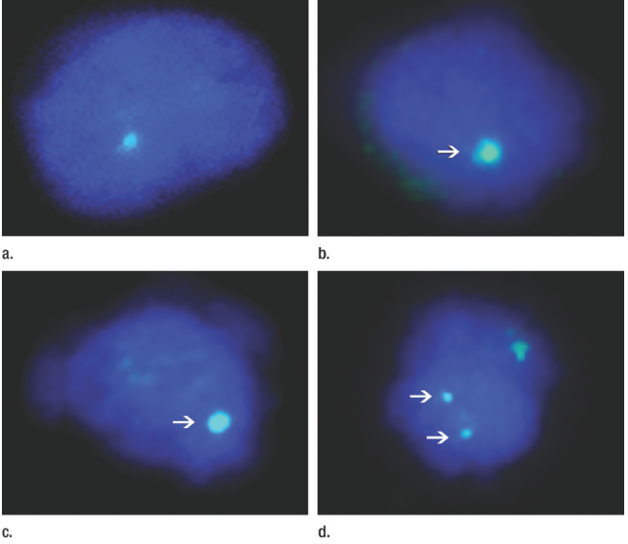
Drawbacks of contrast media
Contrast induced nephropathy (CIN)
Increases short term in-hospital mortality/morbidity
Predisposing factor for long-term loss of kidney function
Incidence of CIN ∝ CM dose
CM amplify DNA radiation damage during CT
(Piechowiak, Peter et al. 2015)
Notes:
Contrast media is double-edged sward. It is essential for the diagnosis, but CIN can be occurred due to CM.
CIN not only increases short term in hospital mortality/morbidity, but also is predisposing factor for long-term loss of kidney function. And incidence of CIN increases as increasing CM dose
Furthermore, according to previous study, iodinated contrast media also amplify DNA radiation damage during CT.
Hence we can say that reducing CM dose is clinically important

Slide 33
Double Dose reduction
Increased HU of iodine in lower kVp protocol
↑ conspicuity of hyper- and hypo-vascular structure or lesions
↓ dose of CM with preservation of CNR of focal lesions
Low kVp
Notes:
Instead of increasing conspicuity of focal lesions, increased attenuation coefficient of iodine in lower kVp image can be used to decrease dose of contrast media with preservation of CNR of focal lesions.

Slide 34
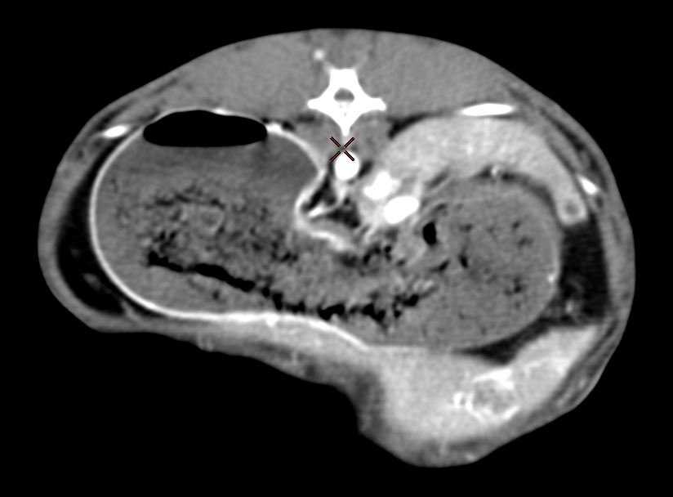
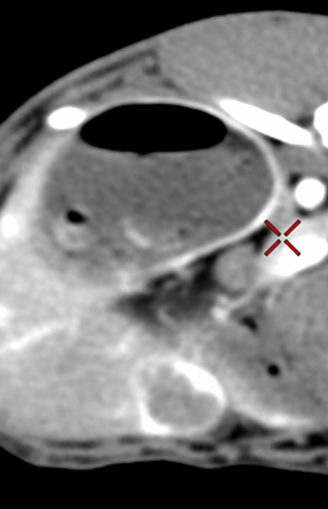
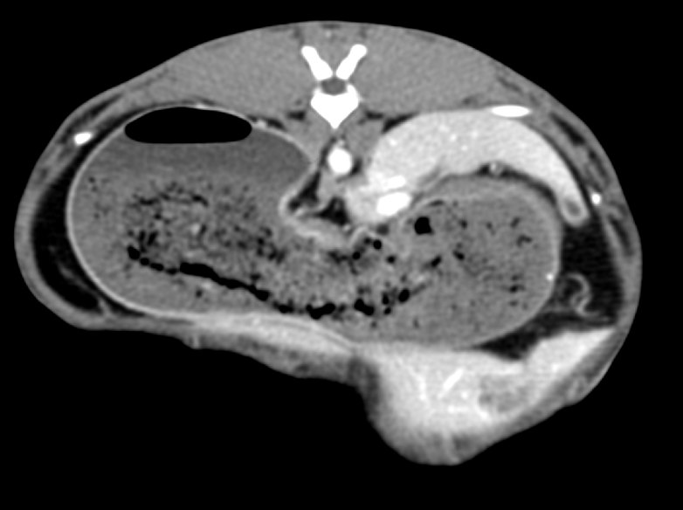
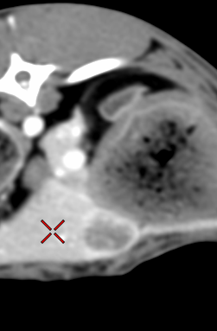
$$CNRratio=\frac{CNR150}{CNR300}=1.28$$
$$CNRratio=\frac{CNR75}{CNR300}=1.24$$
140 kVp, 300mgI/mL
50 keV, 150mgI/mL
140 kVp, 300mgI/mL
60 keV, 75mgI/mL

Slide 35
Double Dose reduction
Authors | CT machine | AEC | CM concentration (mg/mL) | CT protocol | Injection duration | RD reduction | CM Dose reduction | Body weight
Noda (2015) | GE (CT750 HE) | Yes, NI (12.0) | 350 | 120 kVp, 600 mgI/kg vs 80 kVp, 500 mgI/kg vs 80 kVp, 400 mgI/kg | 30 sec | 33% | 7.3%, 19.5%
Takahashi (2014) | GE (64 MDCT) | YES | 320,300, 370 | 120 kVp, 600 mgI/kg, NI=11.0 vs 100kVp, 480 mgI/kg with ASIR 40%, NI=14 | 30 sec | 37% | 20% | BW <70 kg
Namimoto (2012) | Philips (Brillance 64) | Only at 120 kVp | 300, 370 | 120 kVp, 600 mgI/kg, 243-450 mAs vs 80kVp, 386 mAs 450 mgI/kg with IDOSE 60%/40% blend of IR/FBP | 30 sec | 28.% | 25%
Nakaura (2012) | Philips (Brillance iCT) | Yes | 300, 350, 370 | 120 kVp, 600 mgI/kg, ref CTDIvol 20mGy vs 80kVp, ref CTDIvol 12mGy 450 mgI/kg with IDOSE 40% | 30 sec | 48-51% | 40%
Yanaga (2011) | Philips (Brillance 64) | Only at 120 kVp | 370 | 120 kVp, 600 mgI/kg, 300 mAs, ref CTDIvol 20mGy vs 80kVp, 600 mAs, 444 mgI/kg with IDOSE 40% | 30 vs 15 sec | 13% | 26% | BW <70 kg
Shen, Y Int J Clin Pract. 2016 Sep;70 Suppl 9B:B5-B15.
Notes:
This table summarize representative studies of double dose reduction in liver application.
With 80 or 100 kVp, 13-50% radiation dose reduction and 20-40% CM dose reduction had been achieved.
As you can see, all of the studies adapted fixed injection duration, mostly 30 seconds and applied IR to reduce image noise.
One thing we should concern is that officially or unofficially all of the studies included not obese patients
This is because body weight is important factor known to impact the clinical application of the low tube voltage protocol.
Previous study indicated that the patients weighing more than 70kg should be scanned according to the standard 120 kVp protocol to maintain image quality
And the protocol involving an 80 kVp is feasible and reliable only in lean patients.

Slide 36
Summary
mAs modulation
Noise 증가
Radiation dose reduction
kV modulation
Iterative reconstruction
Metal artifact reduction
Contrast media reduction
Double dose reduction

